Slide 1
CEREBRUM
BY
Dr. F.O. OPOOLA

Slide 2
LEARNING OBJECTIVES
To describe the general structure of the cerebrum
To identify the cerebrum, the lobes of the brain
Nerve cell
Types of tissue
Broca`s area
Connecting structures
Functions
Clinical relevance

Slide 3
INTRODUCTION
The cerebrum is the largest part of the brain, Located at the front and top of the skull, it gets its name from the Latin word meaning “brain”.
The largest and most developed information-processing networks of the human brain are found in the cerebrum.
It lies on top of the brainstem and consists of two cerebral hemispheres, an outer layer of grey matter (cortex) and an inner layer of white matter. There are four lobes in the cortex (frontal, parietal, temporal and occipital).

Slide 4
INTRODUCTION
The brain is a main organ of the central nervous system (CNS), and the cerebrum is the largest portion of the brain.
The brain floats within the skull suspended by cerebrospinal fluid (CSF) that serves as a shock absorber and maintains even pressure within the brain.
The two hemispheres of the cerebrum reside above the brainstem (also called the "mid-brain") and the cerebellum at the very back (or bottom) of the brain.

Slide 5
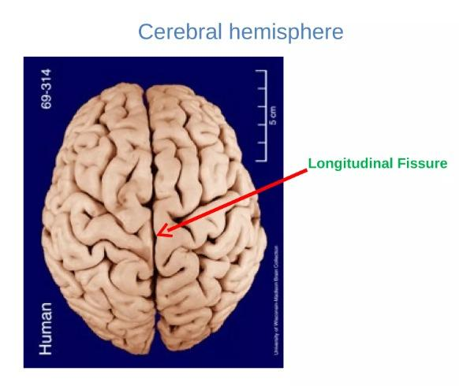
INTRODUCTION
The right hemisphere of the cerebrum primarily controls the left side of the body and the left hemisphere primarily controls the right side.
All areas of the brain work together but each region has its specialties, including regions within the cerebrum.
human brain weighs, on average, about 3 pounds (1300-1400 grams) and the cerebrum accounts for the majority of this weight

Slide 6
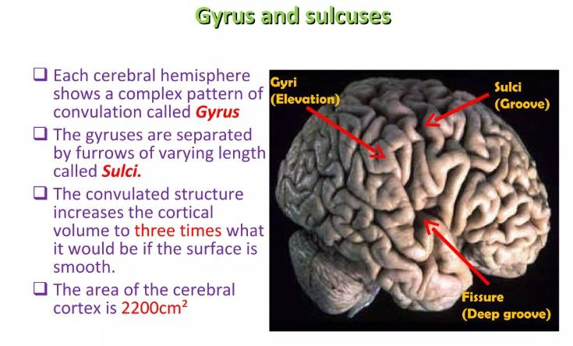

Slide 7
Nerve Cells
The cerebrum does not contain any muscles or ligaments, but it houses several different types of neurons, or nerve cells.
The three main parts of neurons are:
Cell body is the central part of the cell and its command center.
Dendrites are fibers that branch out from the cell body to receive messages from other cells
Axons are fibers that send outgoing messages to the dendrites of other cells
The neurons link to one another in the brain through connection points called synapses.

Slide 8
The three main types of nerve cells inside the cerebrum include:
Sensory neurons, which are responsible for sensation
Motor neurons, which are responsible for voluntary and involuntary movement
Interneurons that connect with other nerves

Slide 9
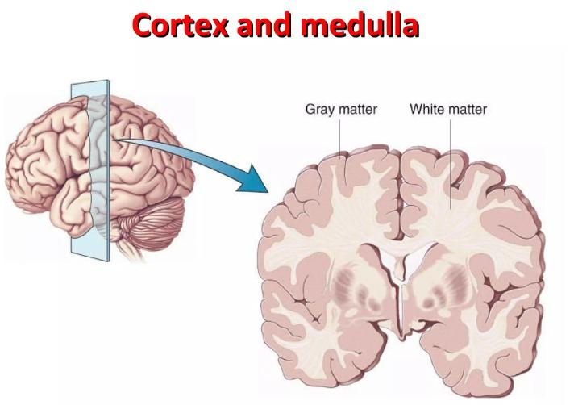
        Types of Tissue
Gray matter, which is named for its gray-brown color, forms the outer surface of the brain and consists of the neurons' cell bodies. This outer layer of gray matter is the cerebral cortex and it is associated with most information processing, including language, perception, and thought.
White matter is an inner core of brain tissue that's mostly composed of axons, or nerve fibers, that are covered by myelin (a type of fat). The myelin gives white matter its white color.
White matter serves as the connectors for gray matter.

Slide 10
The cerebral cortex is the outermost layer of the cerebrum and cerebellum.
The cerebellum is the second largest part of the brain and it is involved in coordinated movement, posture, and balance.
The cerebral cortex has a series of folds that allow for a larger surface area to house more gray matter and its powerful information processing.
Each groove or low point is known as a sulcus. Each ridge or high point is called a gyrus.

Slide 11
Lobes
The gray matter of the cerebral cortex is divided lengthwise into two halves, separated by a deep crease called the longitudinal fissure.
From side-to-side, a crease called the central sulcus divides each hemisphere in half again.
Each half of the cerebral cortex contains four regions called lobes that have different functions:
Frontal lobes reside at the very front of the brain behind the forehead and are responsible for many key functions, such as attention, learning, and speech. The prefrontal cortex (PFC), a forward-facing region of each frontal lobe, allows for planning and complex decision making and is said to house your personality. A rear-facing region is involved in voluntary movements.

Slide 12
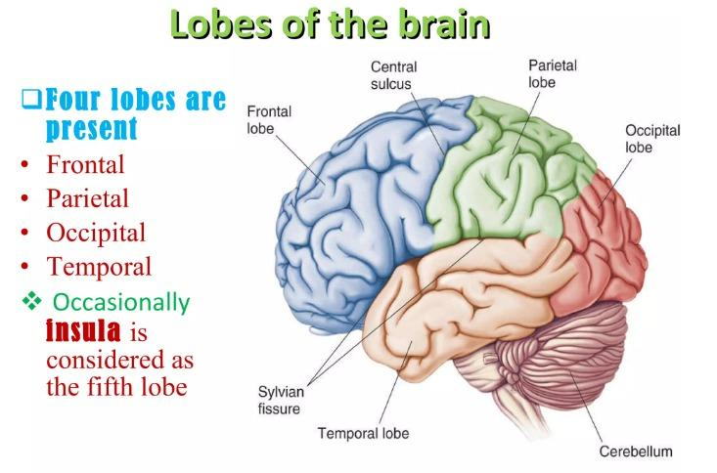
Lobes
Parietal lobes are located near the middle of the brain behind the frontal lobes and are sensory areas that process pain, taste, temperature, and textures along with spatial relationships (such as the distance between your car and the one in front of you).
Temporal lobes sit at the sides of the brain and are responsible for short-term memory, understanding sounds and speech, and musical rhythm.
Occipital lobes are located at the very back of the brain and are responsible for processing what you see.

Slide 13
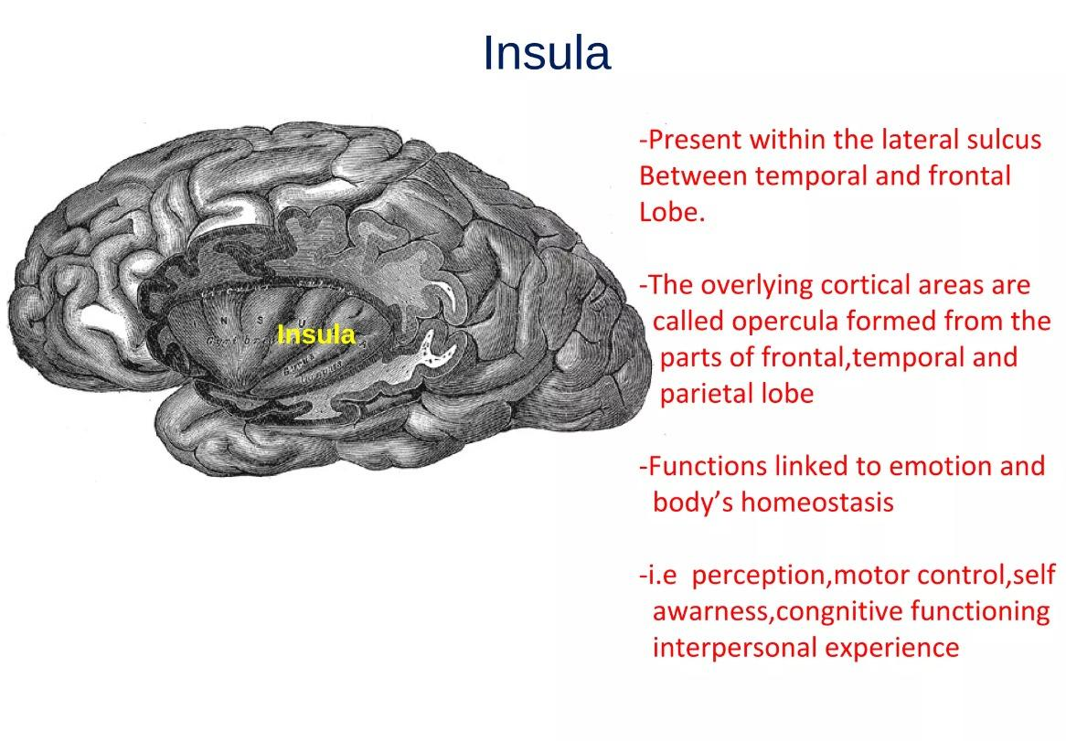

Slide 14
Broca's Area
Broca’s area, which is usually located in the left frontal lobe (in rare cases, it's found on the right side), is a brain region responsible for putting thoughts into words.
It's named after French surgeon Paul Broca who discovered its role in speech in 1861.
Beneath the lobes are the pathways that send messages to other parts of cerebrum and other regions of the brain.

Slide 15
Connecting Structures
The cerebrum also has connecting structures that supply, protect, or enable it to perform its vital functions. These structures include:
Cerebral arteries: Blood vessels that supply the cerebrum with oxygen-rich blood from the heart. There are three cerebral arteries: anterior (front), middle, and posterior (back).

Slide 16
Connecting Structures
Circle of Willis: A loop of cerebral arteries and other connecting arteries at the base of the brain. Blood moves from the two carotid arteries in the neck and the basilar artery near the base of the skull to the circle of Willis and then on to the entire brain.
Meninges: Membranes that cover the cerebrum to protect it from traumatic injury and infection. The meninges also enclose the rest of the brain and the entire spinal cord.

Slide 17
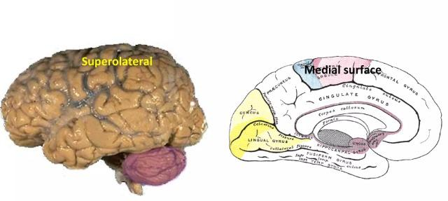

Slide 18
Three layers of tissues make up the meninges. They are:
Dura mater, an outer, cloth-like layer of tissue that covers the brain and sits between the bones of the skull and the cerebrum.
Arachnoid, a middle layer that's a delicate, fluid-filled structure that provides shock absorption in the event of brain movement.
Pia mater, a thin, paper-like structure that lays directly atop the brain.

Slide 19
Function
The role of the cerebrum is to coordinate and process sensory and motor functions required by the body, as well as to provide reasoning functions, process emotions, and contribute the unique personality traits that make each human being an individual.
The cerebrum performs these functions using communication between nerve cells. Some of these processes, such as reasoning, reside completely within the cerebrum itself. Other communications get transmitted down the spinal cord and out into the wider body via a network of neurons.
The cerebrum also processes signals returned to the brain from elsewhere in the body. Pain signals and other nervous communications travel up the spinal cord to the brain.

Slide 20
Clinical Anatomy
Brain trauma occurs if a high-force accident shakes the brain inside the skull or if a projectile penetrates it. The injury may have many consequences and depends on which areas have tissue damage. It can cause trouble with reasoning, emotional regulation, and motor functions.
Infections like meningitis, an inflammation of the meninges, can put pressure on delicate cerebral tissue and damage it. Similarly, hydrocephalus, which means "water on the brain," is a condition in which too much cerebrospinal fluid builds up under the arachnoid or within the cerebrum, raising pressure. Sometimes there's significant brain damage.
Cancerous and benign (noncancerous) tumors can arise within the cerebral tissue. These growths may require treatment, or doctors may take a "watchful waiting" approach to see if they cause symptoms like vision disturbance or personality changes.
Stroke is a common condition that destroys cerebral tissue and often results in partial paralysis, difficulty speaking, and other disabilities. Stroke occurs when a blood clot blocks oxygen from reaching a brain region or when a blood vessel bleeds onto the surrounding tissue, destroying it. The effects of the stroke can depend on which lobe it affects. For example, a temporal lobe stroke can affect speech and hearing and an occipital lobe stroke can cause vision loss.

Slide 21
Clinical Anatomy
Alzheimer's and other dementias usually cause progressive memory loss, trouble with reasoning, and sometimes personality changes. Alzheimer's appears to be caused in part by the buildup of certain types of plaques that interfere with neural communications.² Vascular dementia may be caused by disease processes that cause narrowing of the cerebral arteries and disruption of blood flow within the cerebrum. Certain types of dementias, like Lewy body dementia, are associated with other conditions, such as Parkinson's disease.

Slide 22
Summary
The cerebrum is a major part of the brain and its upper layer called the cerebral cortex is responsible for a range of complex functions.
The cerebrum is the source of intellect and personality. It helps you move and understand what you see, hear, touch, and smell.
Due to the cerebrum's many important roles, damage to any of its lobes from injuries, illnesses, or chronic conditions can cause major losses in brain function.
Each lobe has its specialities, but communication occurs across the cerebrum and other areas of the brain.

